Slide 1


COVID HEALTH CARE WEBSITE
BY TEAM-
CYPHERS

Slide 2


TEAM CYPHER
AS NAME SAYS CYPHERS WHICH MEAN A SECRET OR DISGUISED WAY OF WRITING OR IN SIMPILE WAY ITS KNOWN AS CODING.
SO WE HAVE TAKEN THIS NAME BECAUSE OUR WHOLE WORK AND PROJECT IS IN CODING
TEAM MEMBERS:
1. SKANDH VISHWAMBHAR LATG10061
2. RITIK MALHOTRA LATG10061

Slide 3
INTRODUCTION
WE HAVE BASICALY DEVELOPED THIS WEBSITE “COVID HEALTHCARE WEBSITE” TO OVERRIDE THE PROBLEMS PREVALING IN THIS PRACTICING MANUAL SYSTEM OF CORONA DURING THIS HARD TIME OF PANDEMIC.
THIS IS TOTALLY SIMPLE SITE WITH SIMPLE FORMAT SO NO FORMAL KNOWLEDGE IS NEEDED FOR SURFING THIS WEBSITE AND HAS USER FRIENDLY OUTPUT AND FONTS.
AND IT WILL BE REALLY HELPFUL IN HARD TIME OF NEEDY PEOPLE AND HE/SHE CAN SAVE LOTS OF TIME.

Slide 4

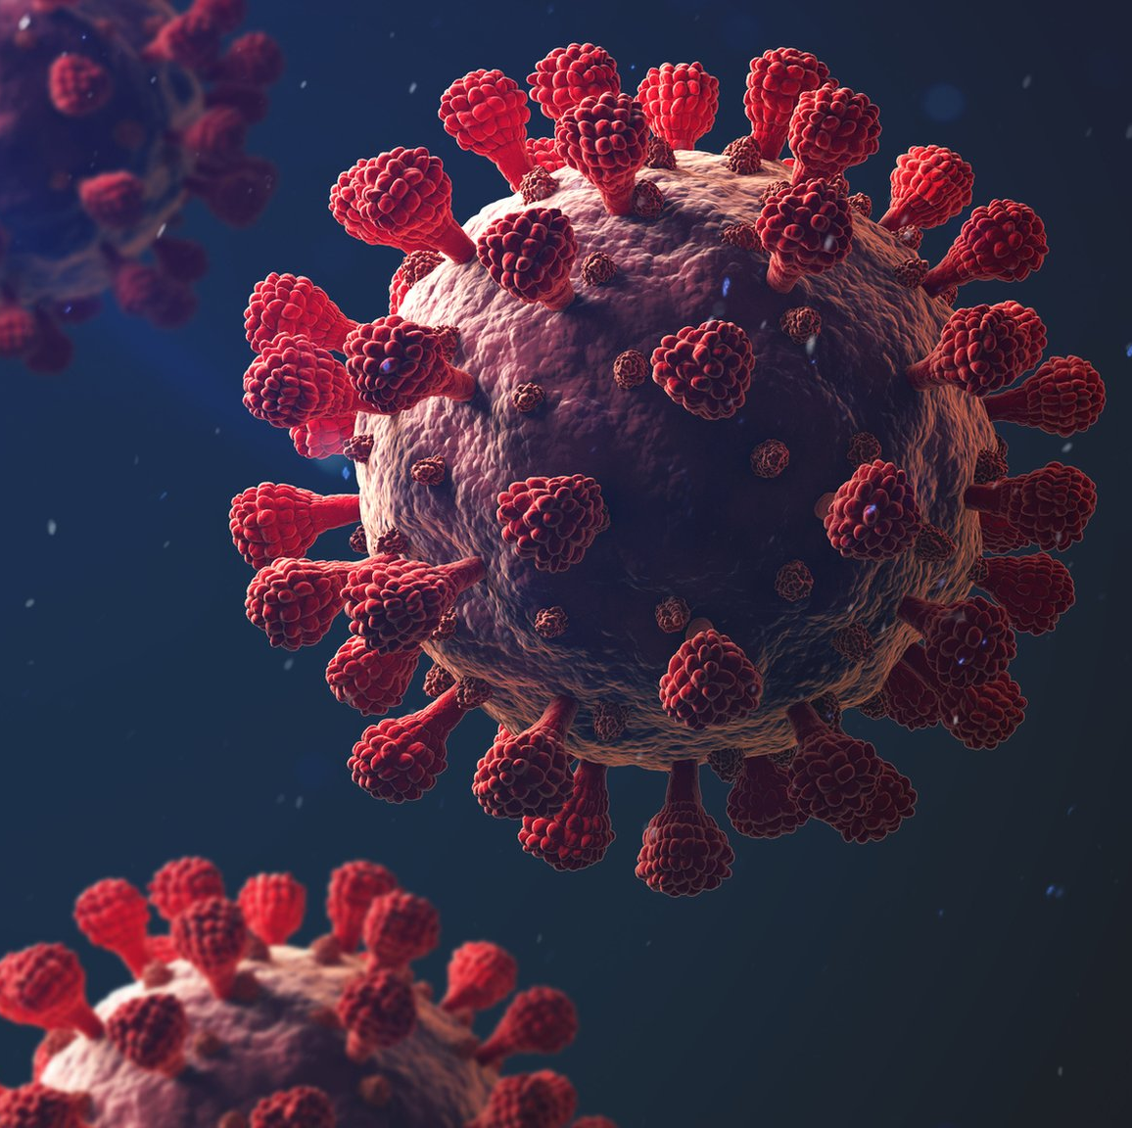
COVID HEALTH CARE WEBSITE
AS WE KNOW WHOLE WORLD IS GOING THROUGH COVID PANDEMIC AND MANY PEOPLE ARE LOSING THEIR LIVES AND LOVED ONES BECAUSE OF COVID
AND ESPICALLY IN SECOND WAVE IN INDIA WE HAVE SEEN THE LACK OF REQUIRED INFORMATION OR WRONG INFORMATION REALTED TO HOSPITAL AND DOCTOR CAUSED DELAY IN TIME AND THIS DELAY RESULT IN DEATHS OF MANY PEOPLE

Slide 5
COVID HEALTHCARE WEBSITE
SO, WE HAVE GONE THROUH HARD TIME SO OUR TEAM DECIDED TO MAKE THIS WEBSITE
THAT WILL HELP PEOPLE BY PROVIDNG RIGHT INFORMATION AT RIGHT TIME
THIS WILL TELL USER BEDS AVILABLITY, OXYGEN AVILABLE,DOCTOR AVILABLITY ETC.

Slide 6

SCOPE OF COVID HEALTHCAREWEBSITE
IT MAY HELP COLLECTING THE RIGHT DETAIL IN VERY SHORT TIME REQUIRED BY USER.
ITS EASY TO UNDERSTAND
USER FRIENDLY
EXPLABDALE FOR FUTURE UPDATION
SAVE LOT OF TIME

Slide 7

COMPONENTS USED IN MAKING THIS WEBSITE
WE HAVE BASCIALLY USED HTML,JAVASCRIPT,CSS FOR FRONT END OF WEBISTE
AND FOR DATA BASE MANAGEMENT WE USED MYSQL AND PHP SO THAT WE CAN MANAGE EFFICENTLY .

Slide 8

FUTURE PLANS
IN FUTURE AS WE CAN EASILY UPGRADE AND MODIFY OUR WEBSITE EASILY WITH MORE USEFUL FEATURES AS NEEDED BY PEOPLE IN FUTURE.
LIKE:
TRY TO ADD HEALTH FEATURES
TRY TO ADD LOCATION FEATURE OF ONES SUFFERING WEBSITE
ONLINE CONSULTANCY OF DOCTORS

Slide 9

MAIN ATTRACTION
ITS TOTALLY BASED ON COVID RELATED INFORMATION
ITS EASY TO USE AND RESPOSIVE
ITS UPGRADABLE
PROVID IMPROTANT INFORAMTION IN QUICK TIME

Slide 10


Slide 11

THANK YOU TEAM CYPHERS

